Slide 1
MEDPAD
PIP104 University Project-II
Review-1
Batch Number: 205
Roll Number | Student Name
20211IST0023 | Hitesh D
20211IST0026 | Sushmitha V M
20211IST0020 | Shamitha R
Under the Supervision of,
Dr. Pallavi R
School of Computer Science & Engineering
Presidency University
Name of the Program Project Coordinator: Prof. Srinivas Mishra
School of Computer Science & Engineering
Presidency University

Slide 2
Introduction
Inefficient working done by Medical Representatives is one of main reasons for the poor sales figures of Pharmaceutical companies. Poor MRs in a company are like poor politicians, you need them also and can’t do much to improve their performance also. Medpad is a one stop solution consisting of all tools which can help a Medical Representative work with a lot more efficiency and yield better results.
Medpad is an application expected to be used by Medical Representatives to perform their daily word. Medpad is packed with a lot of unique features which will surely help attain the goal of 10x prescriptions.
Creating a web application for MRs to facilitate achievement of the goal of 10x prescription. The idea is expected to yield efficient sales figures from MRs as well as expedite the communication between doctors and Medical Representatives.

Slide 3
Literature Review
Reference | Title | Year | Technique/ Methodology | Key Findings | Applications
[1] | The Role of artificial intelligence in healthcare: a structured literature review | 2021 | The study applied SL(Structured Literature Review) method. It includes Bibiliometric Analysis. | AI Applications in Healthcare, Trends and Opportunities. | AI supports predictive medicine, contributes to diagnostic improvements.
[2] | Influence of artificial intelligence in modern pharmaceutical formation and drug development | 2024 | It uses Artificial Neural Networks for optimizing drug formulations. ML and DL Tools. Quantitative Structure-Activity Relationship. | Optimization of Drug Formulation, AI in Drug Discovery, Personalized Medicine. | Drug Formulation, PharmaceuticalManufacturing.

Slide 4
Literature Review
References | Title | Year | Technique/Methodology | Key Findings | Applications
[3] | Inventory Management and Control Of Deteriorating Pharmaceutical Products U sing Industry 4.0 | 2021 | The methodology used includes content analysis and literature review, highlighting how Industry 4.0 tools such as IoT, RFID, cloud computing. | Increasing in Pharmaceutical Supply Chains[PSC], Industry 4.0 Applications in PSC, Sustainability Benefits. | Healthcare Systems, Pharmaceutical Companies, Environmental Sustainability.
[4] | MoRe-Care: Mobile-Assisted Remote Healthcare Service Delivery | 2018 | It includes designing a mobile healthcare system, MoRe-Care, which integrates mobile technologies with healthcare services to enable remote monitoring. | Improved Healthcare Delivery, Mobile Integration. | Remote Healthcare Monitoring, Telemedicine.

Slide 5
Literature Review
References | Title | Year | Technique/Methodology | Key Findings | Applications
[5] | Data Integration Along the Healthcare Supply Chain: The Pharmaceutical Extranet Gateway Project | 2020 | This paper investigates the Pharmaceutical Extranet Gateway (PEG), Data Integration Approach. | Enhanced Collaboration, Improved Supply Chain Efficiency. | Healthcare Supply Chain.
[6] | A Survey of Personalized Medicine Recommendation | 2021 | It includes models for personalized medicine recommendation, Data-Driven Approaches, Evaluation Methods. | Medicine Combinations, Medical Knowledge Integration, Challenges in Safety and Interpretability. | Clinical Decision Support Systems, Chronic Disease Management.

Slide 6
Objectives
MedPad is designed to address the inefficiencies in the daily operations of Medical Representatives (MRs) and enable them to reach their goal of 10x prescriptions. The objective of this project is to create an all-in-one, user-friendly mobile and web application that equips MRs with tools to enhance productivity, streamline doctor communication, and ultimately boost sales performance.
Here are the primary objectives of the MedPad project:
1. Enhance MR Efficiency through Data-Driven Insights
Objective: Provide MRs with real-time data analytics and AI-driven insights to make smart, data-backed decisions.
2. Streamline Doctor Communication and Engagement
Objective: Facilitate quick and efficient communication between MRs and doctors, improving relationship building and response times.

Slide 7
Objectives
3.Increase MR Motivation and Sales Performance
Objective: To boost MR motivation and overall sales performance where sales statistics .
4.Creating a Robust, User-Friendly Platform
Objective: Ensure that the platform is intuitive, easy to use, and minimizes the learning curve for MRs.
5.Product Recommendation System
Objective:significantly enhance the effectiveness of Medical Representatives (MRs) by providing data-driven suggestions on which pharmaceutical products to promote to specific doctors.

Slide 8
Methodology
1. Project Planning & Requirement Gathering
Objective: Define the scope of the project, gather detailed requirements, and set clear goals.
2. Design & Architecture
Objective: Design the system architecture and application workflow, ensuring the recommendation engine is scalable, responsive, and integrated seamlessly with the app.
System Architecture Design:
Frontend ( Web): HTML, CSS, JavaScript ,React.js
Backend: Implemented using Node.js, Python(flask).
ML Recommendation System: Sales statistics and Top-Selling Products Suggesting products, considering sales trends and doctor preferences.
API’s: Restful, zoom API’s

Slide 9
Methodology
Database Design:
Using relational databases (MySQL) for structured data
Wireframes for Designing Frontend pages:
Design wireframes for MR dashboards, recommendation screens, etc.
Micro Services:
Docker for containerization.

Slide 10
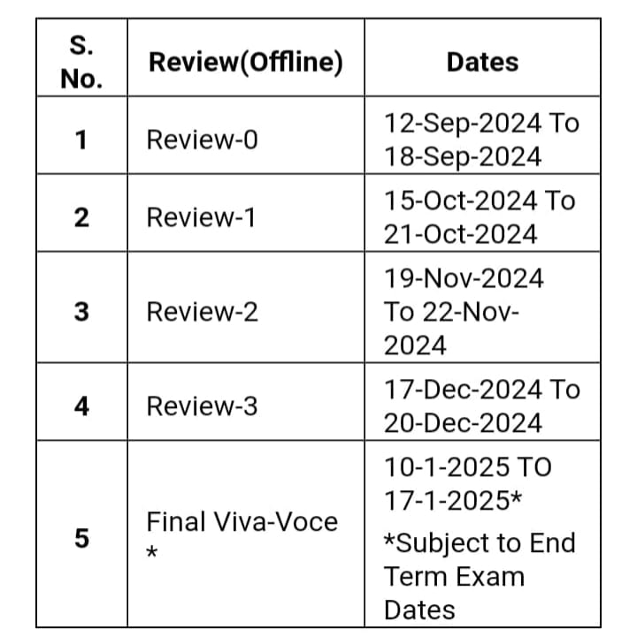
Timeline of Project

Slide 11
Expected Outcomes
Increased market reach.
Increased Prescription Rates
Better MR performance .
Streamlined workflows and digitized processes.
Enhanced doctor engagement .
Data -driven decision making
Sentiment analysis and feedback loop

Slide 12
Conclusion
The MedPad project, aims to revolutionize the way Medical Representatives (MRs) engage with doctors, increase prescription rates, and ultimately drive pharmaceutical sales.
By leveraging data-driven insights, machine learning, and AI technologies, MedPad empowers MRs with personalized recommendations that optimize their time, enhance doctor interactions, and focus their efforts on high-impact opportunities.
Ultimately, MedPad is not just a tool—it’s a strategic enabler for pharmaceutical companies aiming to increase sales, expand market presence, and build sustainable growth in an increasingly competitive marketplace. By implementing this system, pharmaceutical companies can achieve the ambitious goal of 10x prescriptions, transforming both MR performance and overall business outcomes.

Slide 13
References
[1] Secinaro, S., Calandra, D., Aurelio, S., Muthurangu, V., & Biancone, P. (2021). Role of Artificial intelligence in healthcare: a Structured Literature Review. BMC.
[2] Kazi Asraf Ali, S. M. (March 2024). Influence of artificial intelligence in modern pharmaceutical formation and drug development. Future Journal of Pharmaceutical science, 10. doi:10.1186/s43094-024-00625-1
[3] Amirhossein Mostof, V. J. (2021). Inventory Management and Control Of Deteriorating Pharmaceutical Products U sing Industry 4.0. 2021 IEEE 8th International Conference on Industrial Engineering and Application (pp. 394-400). IEEE. doi: https://doi.org/10.1109/ICIEA52957.2021.9436744
[4] R. Das, S. M. (2018). MoRe-Care: Mobile-Assisted Remote Healthcare Service Delivery. 10th International Conference on Communication Systems & Networks (COMSNETS), Bengaluru, India (pp. 677-681). IEEE. doi:0.1109/COMSNETS.2018.8328294.
[5] G.M. McGrath, E. M. (2020). Data Integration Along the Healthcare Supply Chain: The Pharmaceutical Extranet Gateway Project. Proceedings of the 34th Hawaii International Conference on System Sciences. IEEE. doi:10.1109/HICSS.2001.926556
[6] Fanglin Zhu, , Lizhen Cui, Yonghui Xu, , and Zhiqi Shen (2023). A Survey of Personalized Medicine Recommendation. I, 8(2), 77-82. doi:10.26599/IJCS.2023.9100013

Slide 14
Thank You

